Slide 1
COLLOBORATION WEBSITE chat wiz

Slide 2
Agenda
Technologies used.
High Level Architecture
Front End Architecture
Back End Architecture
Overall Architecture

Slide 3
MODULES
USERS (Admin and User)
BLOG
FORUM
JOBS
FRIENDS
CHAT

Slide 4
Technologies
Front End(Dynamic web-app)
Angular JS
HTML,CSS,JS
Bootstrap Etc.,
Back End (Maven Web App)
Spring Restful Web services
Hibernate
H2

Slide 5
Others
Maven
Junit
SLF4J
Git Hub
Server
APACHE TOMCAT SERVER- Version 8
ECLIPSE IDE –version-Mars.2 Release ( 4.5.2 )

Slide 6
High – level architecture
I
N
T
E
R
N
E
T
Back End Project
Angular JS
(Front End Project)
Spring Web Services

Slide 7
Front End Architecture
I
N
T
E
R
N
E
T
HTML Page
Rest Service call
Angular Controller
Angular Service

Slide 8
Back End Architecture
Spring Rest Controller
Spring Repository
(DAO)
Hibernate
H2
Domain Objects

Slide 9
Complete Architecture
HTML Page
Angular Controller
Angular Service
INTERNET
Spring Rest Controller
Spring Repository
(DAO)
Hibernate
H2
Domain Objects

Slide 10
FUNCTIONALITIES
Admin
Approve /Disapprove blog
Post Forum
Add/Delete Jobs
User
Add/Delete /like/comment Blogs
View/like/comment Forums
Apply for Jobs
See friends/make friends
Chat with Friends

Slide 11
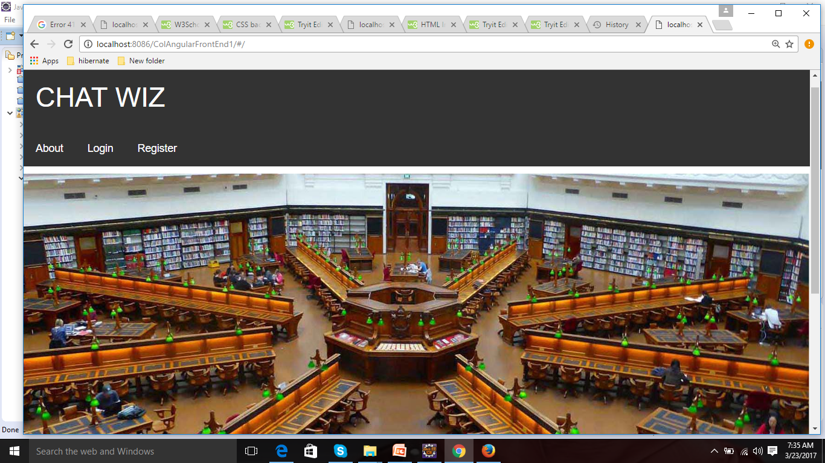
LANDING PAGE

Slide 12
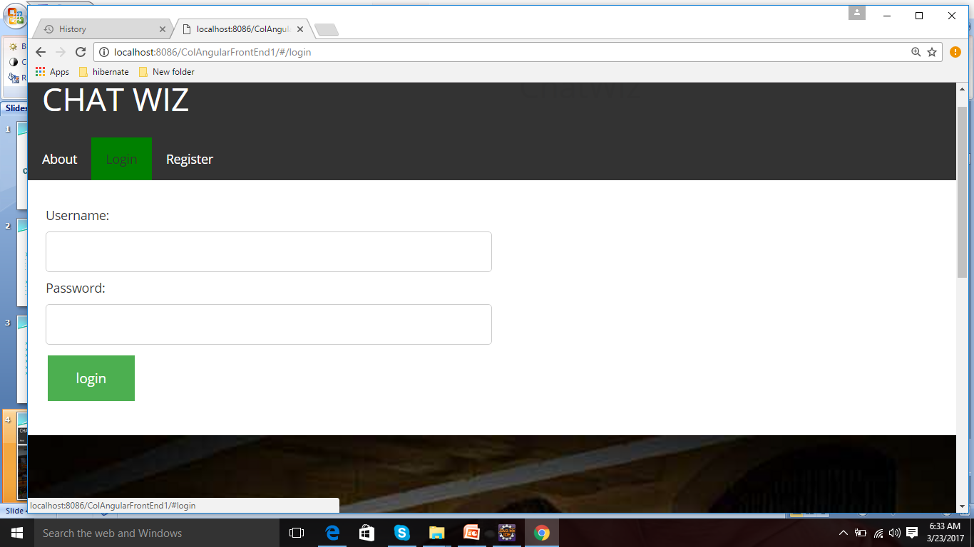
LOGIN

Slide 13
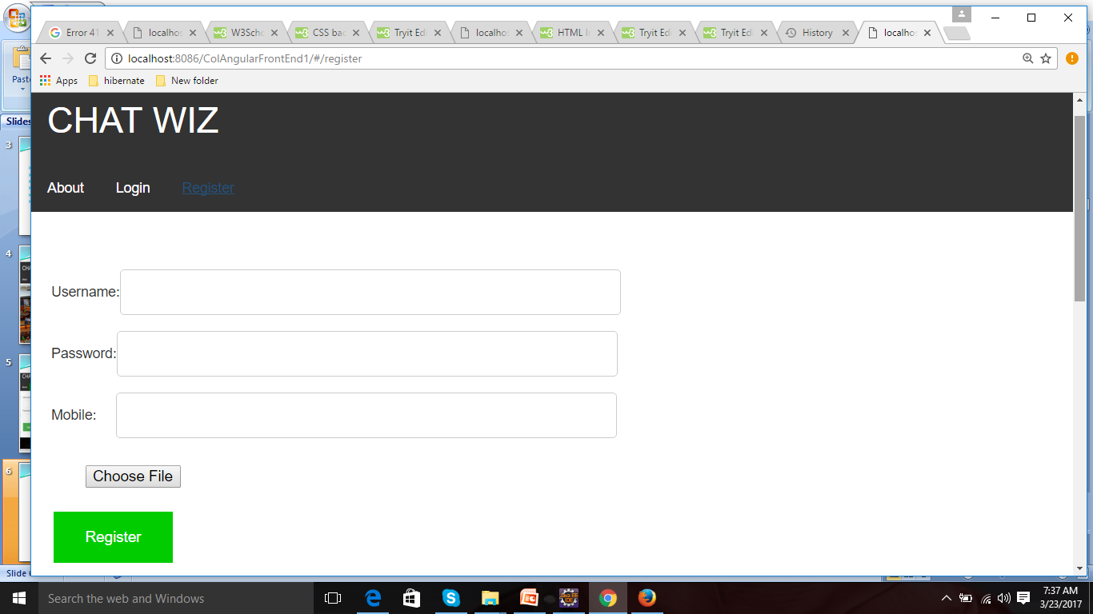
REGISTER

Slide 14
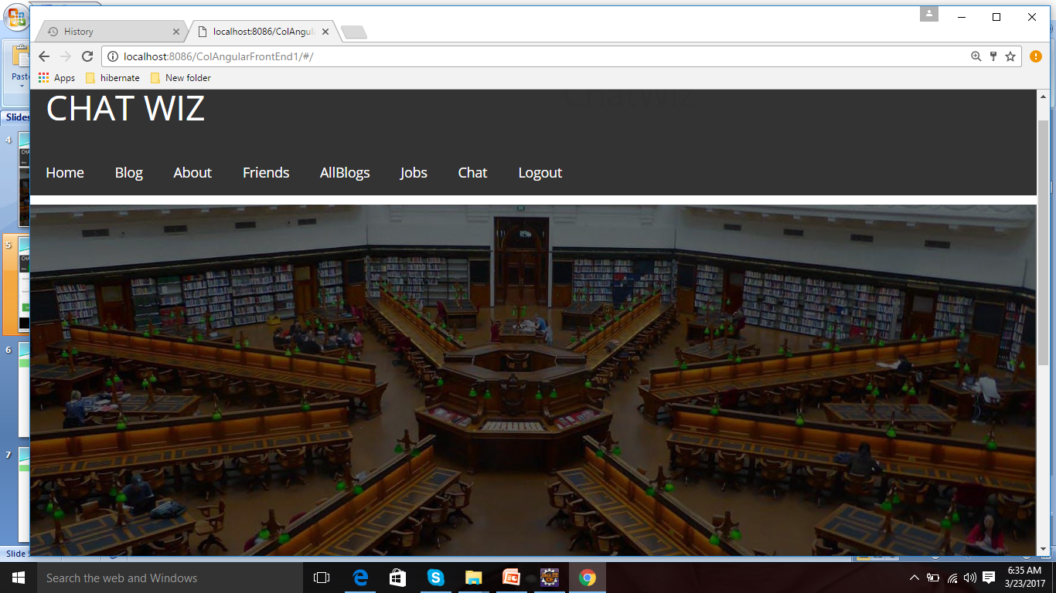
After Login

Slide 15
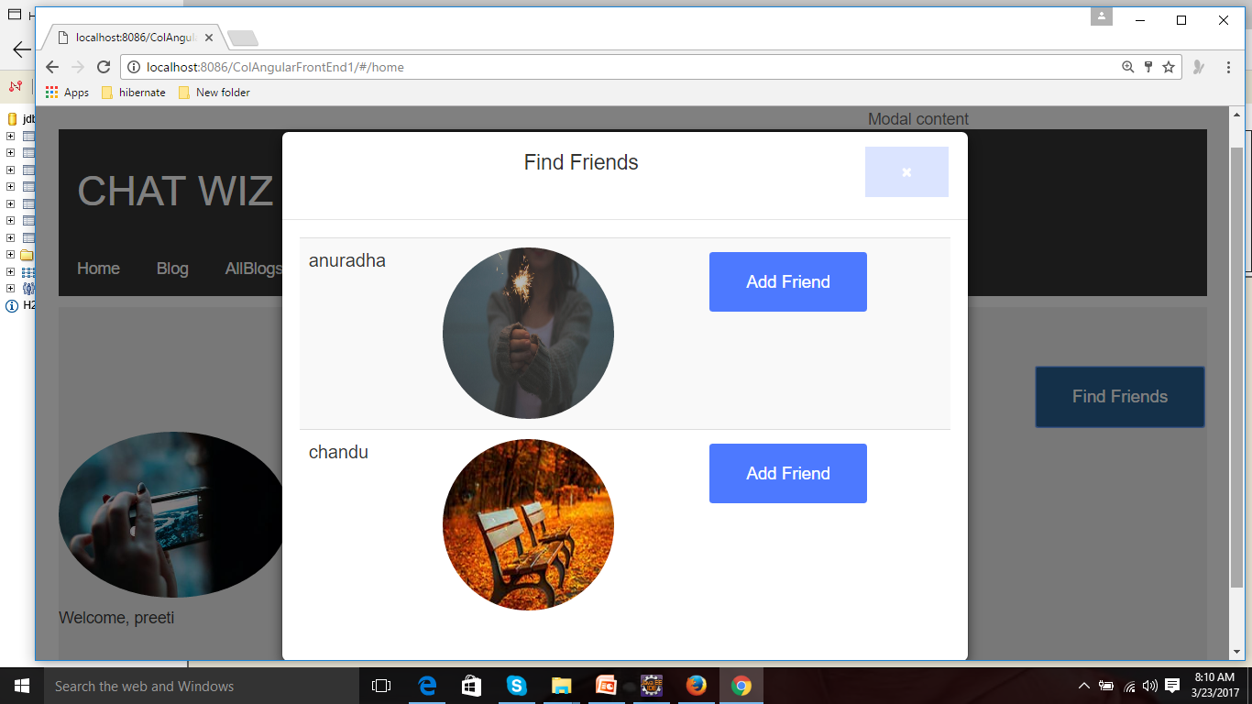
HOME

Slide 16
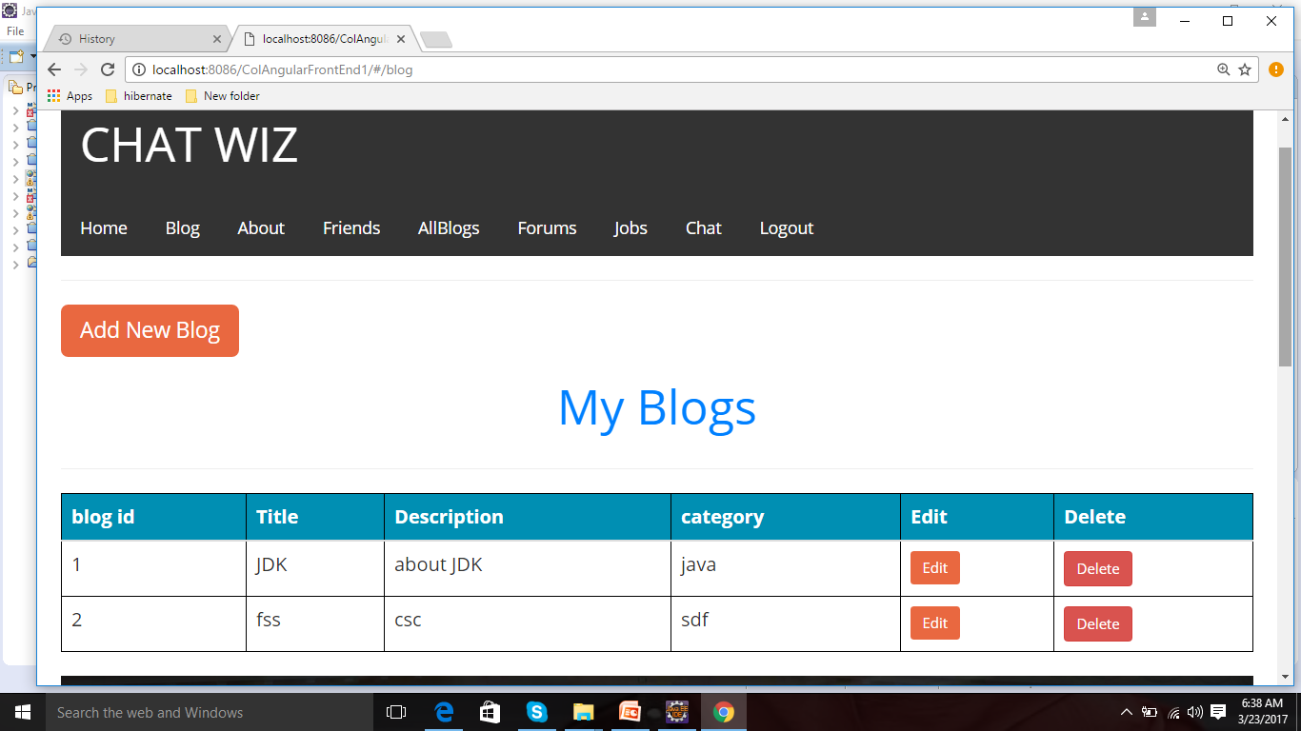
BLOG

Slide 17
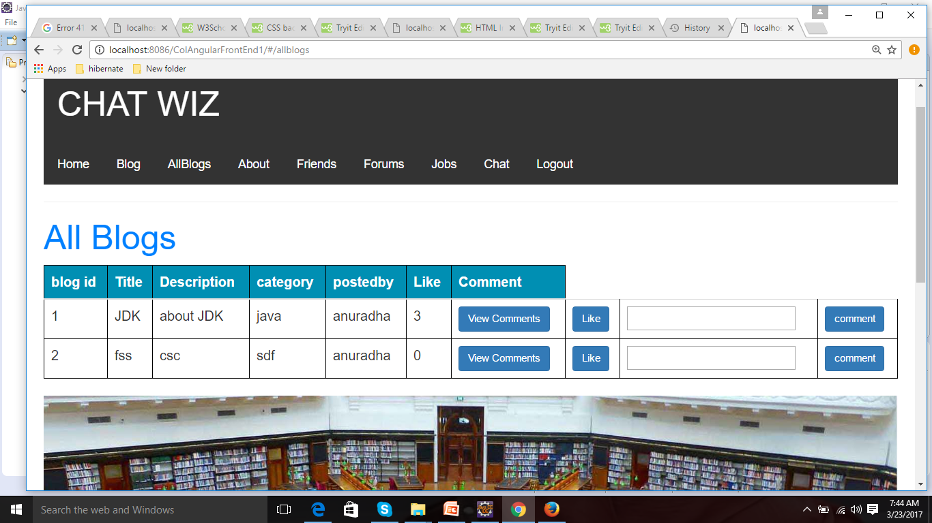
ALLBLOGS

Slide 18
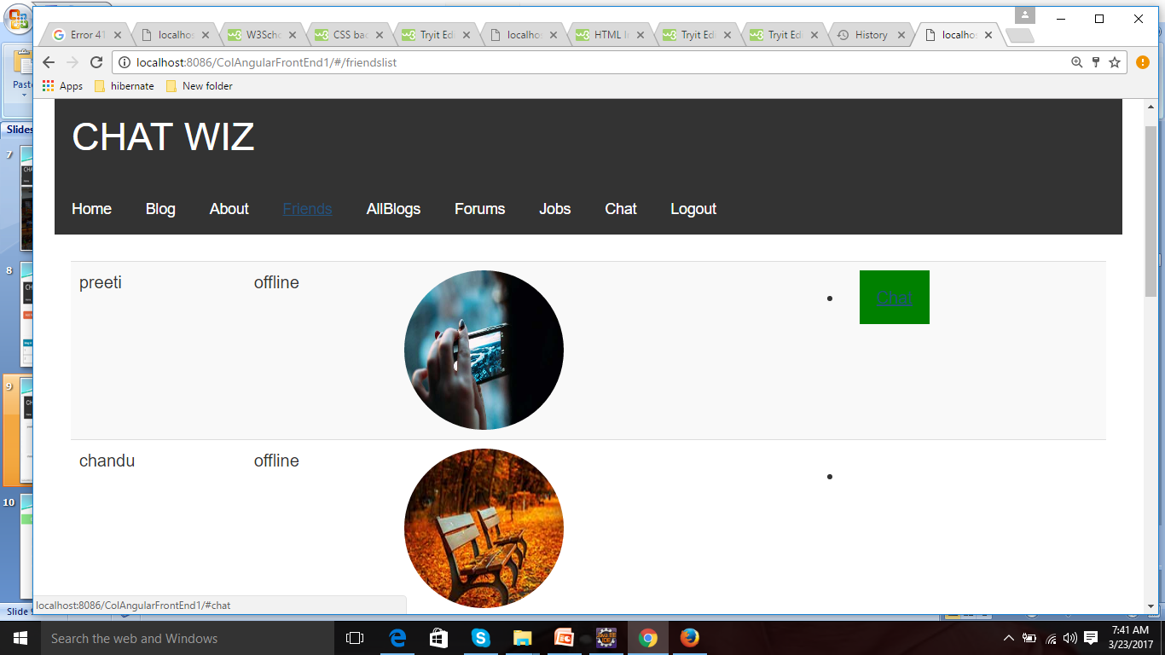
FRIENDS

Slide 19
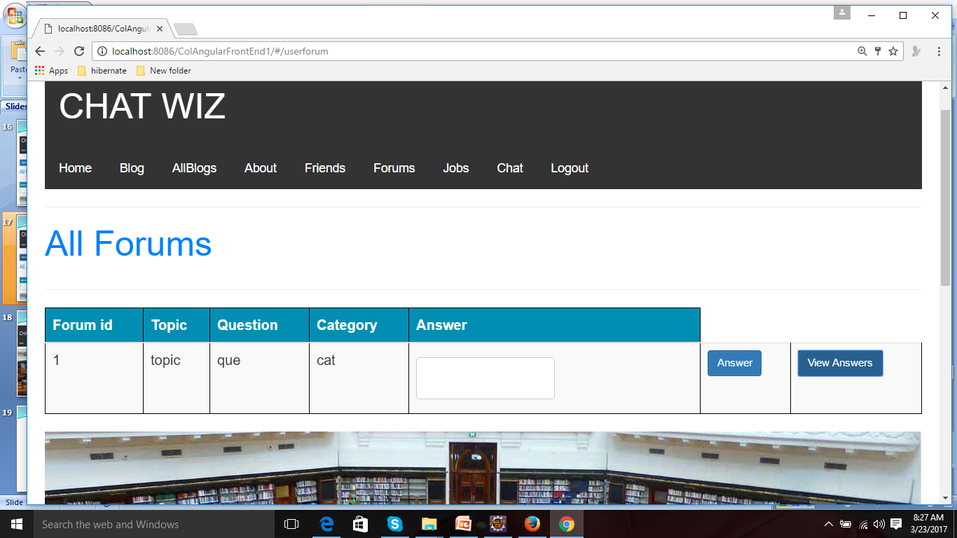
FORUM

Slide 20
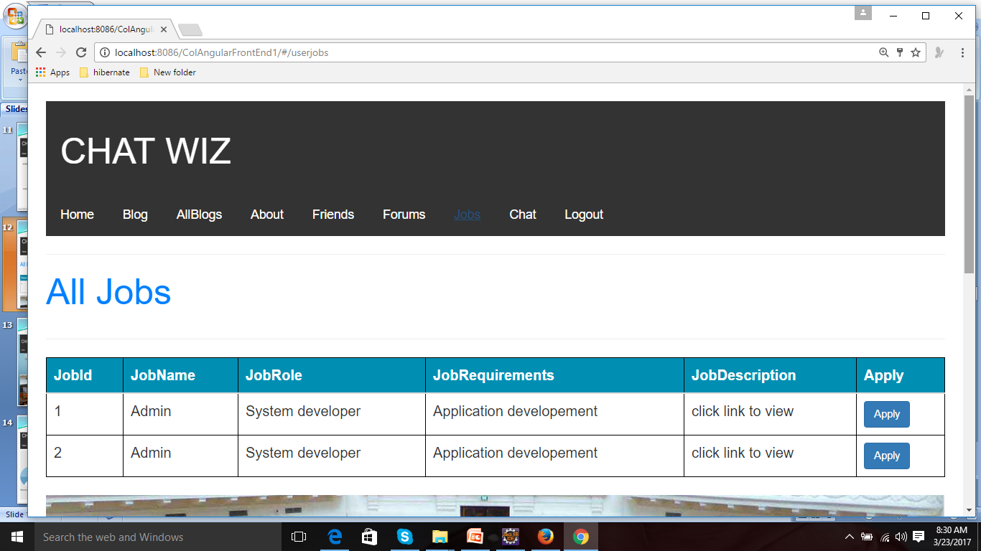
JOBS

Slide 21
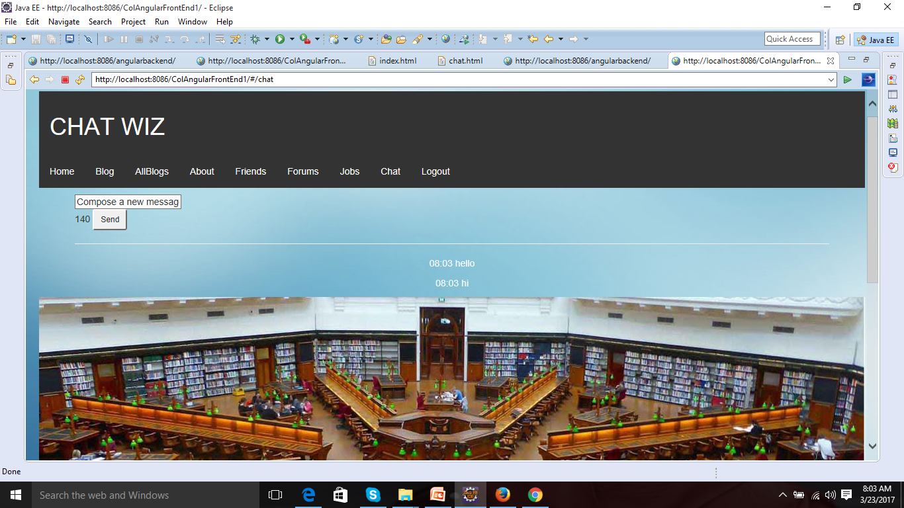
CHAT

Slide 22
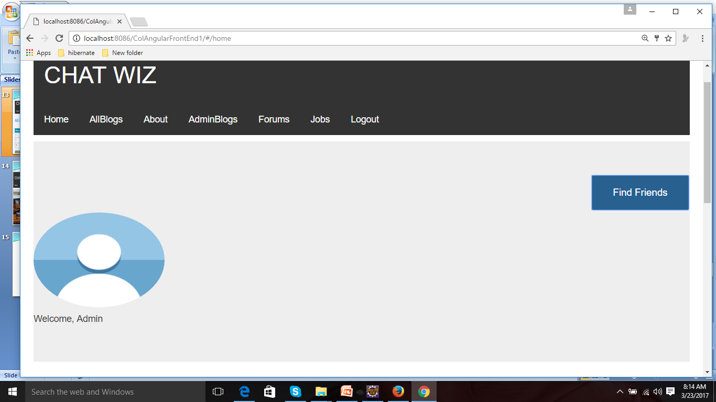
ADMIN LOGIN

Slide 23
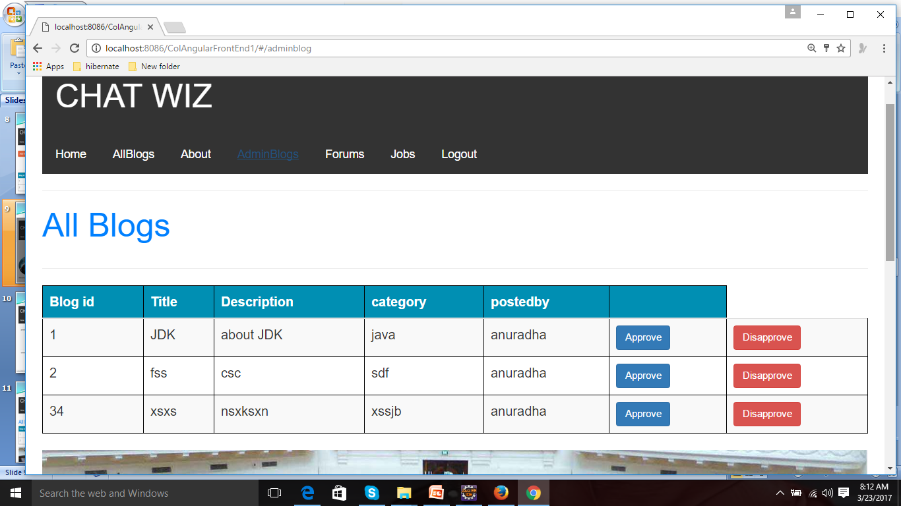
ADMIN BLOGS

Slide 24
ALLBLOGS

Slide 25
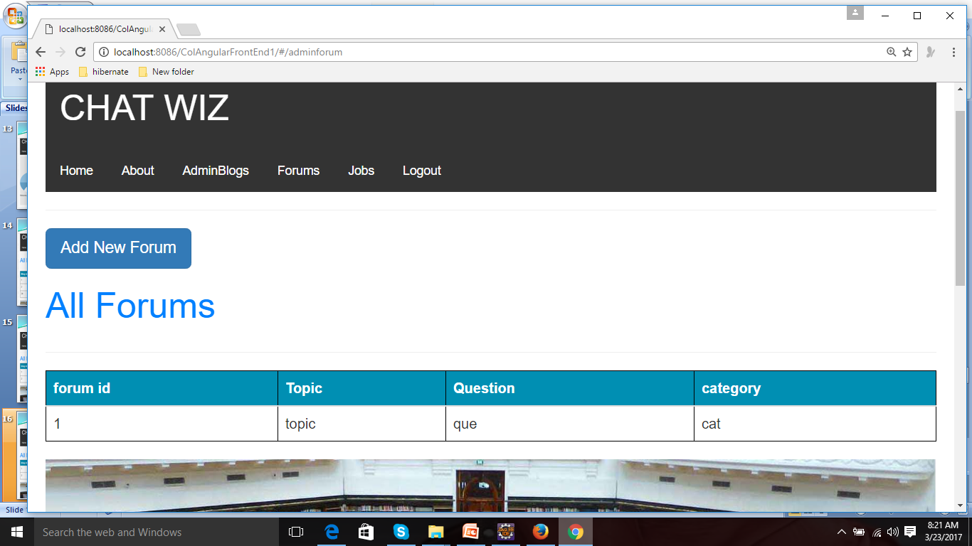
FORUM

Slide 26
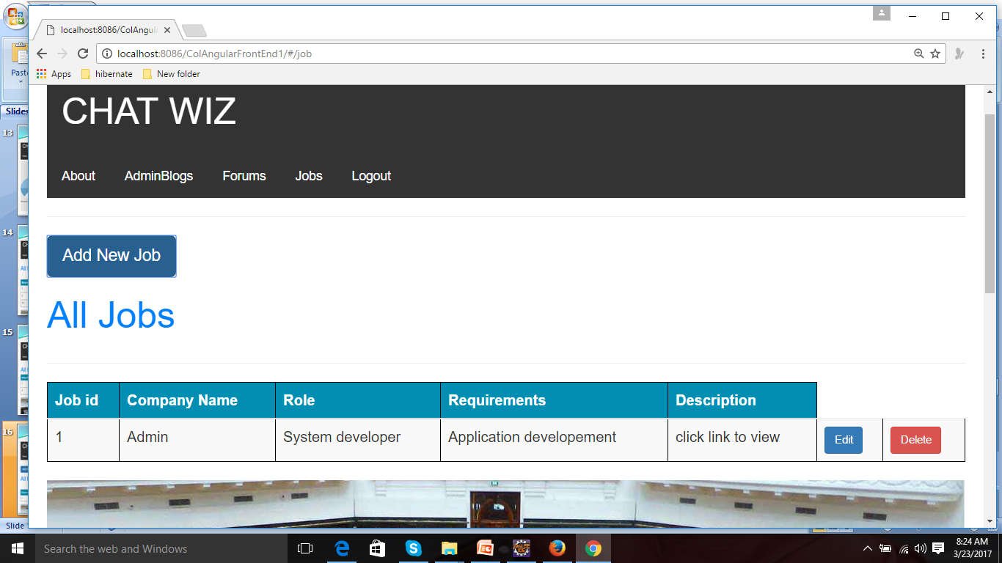
JOBS

Slide 27
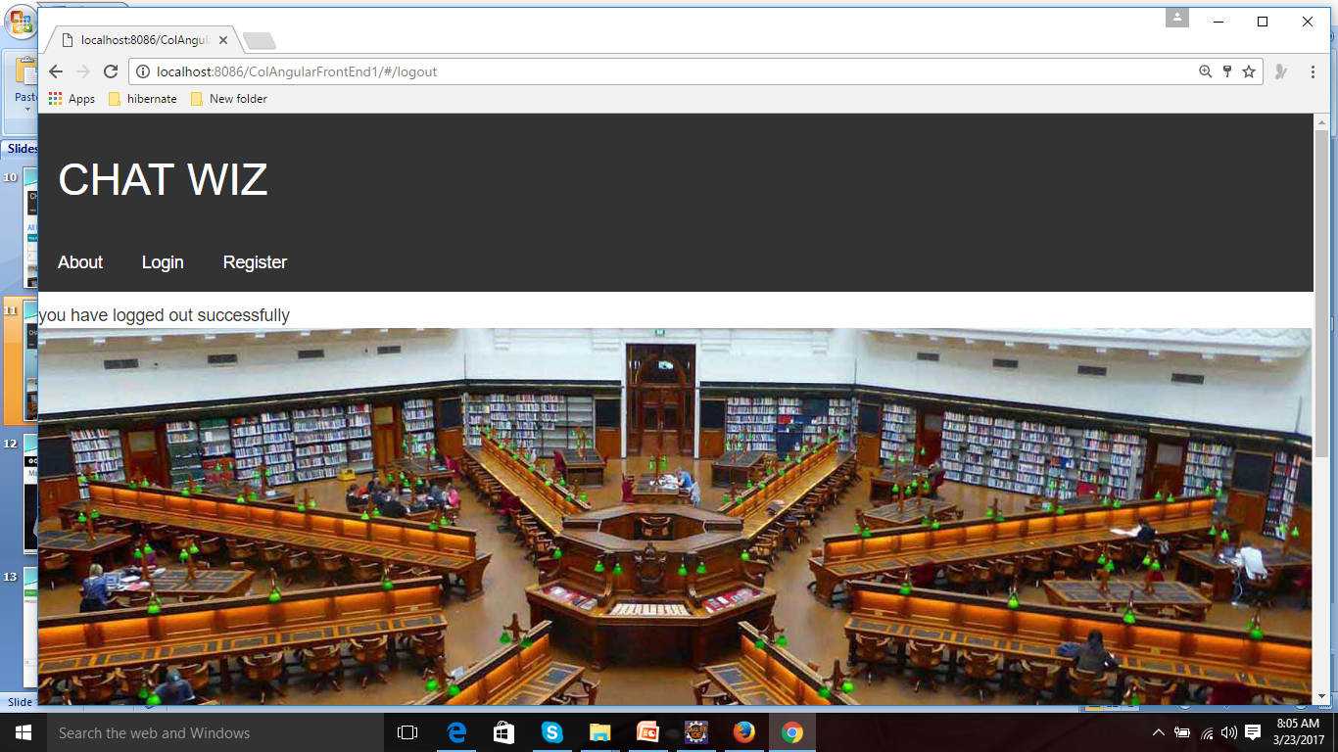
LOGOUT

Slide 28
Thank you

